Slide 1
Summer Internship/ Summer Project -- EC5512
Project Title : CONGEST AI
Project Guide : Dr. T. SRIDARSHINI
Name : K. RUBESH
Register No : 2022105702

Slide 2
Objective
Traffic signal timing control According to the number of flow of vehicle.
It is used to reduce the Idling time of vehicle in traffic.

Slide 3
Components Used:
Hardware:
Microprocessor: Raspberry pi 4b+
LED Traffic Light Signal Module
Software:
Python v3.10.11

Slide 4

Block diagram :
5V DC Power Supply
Raspberry pi
OUTPUT:
LED Traffic Light
Signal Module
Input : Traffic
Video from
Camera
Signal Timing Algorithm
Vehicle Detection
Algorithm

Slide 5
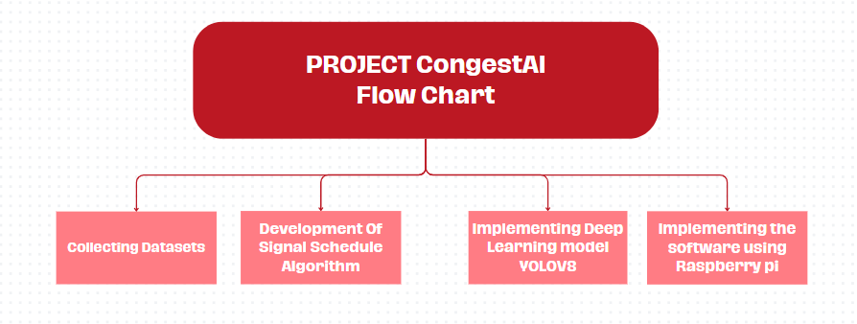

Slide 6
Deep Learning:
a subset of machine learning that uses multilayered neural networks, called deep neural networks, to simulate the complex decision-making power of the human brain
Artificial Neural Network has an input layer, an output layer as well as hidden layers
The input layer receives data from the outside world which the neural network needs to analyze or learn about

Slide 7
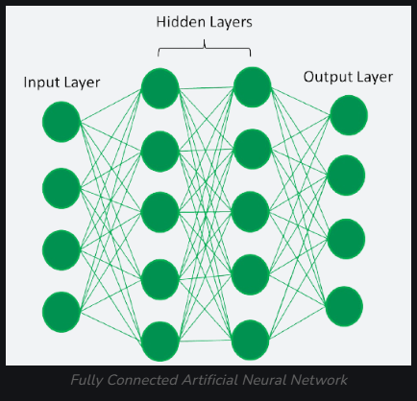
Neural network

Slide 8
Why Deep Learning
High accuracy: Deep Learning algorithms can achieve state-of-the-art performance in various tasks, such as image recognition
Automated feature engineering: Deep Learning algorithms can automatically discover and learn relevant features from data without the need for manual feature engineering

Slide 9
Why Deep Learning
Convolutional neural networks (CNNs), a type of neural network are used primarily in computer vision and image classification applications
They can detect features and patterns within images and videos, enabling tasks such as object detection, image recognition, pattern recognition and face recognition
For vehicle detection, Cnn algorithm(yolov8) is used.

Slide 10
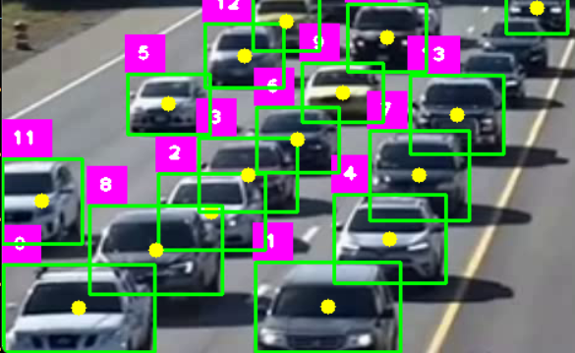
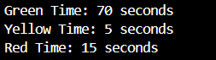
Working:
Case 1: High traffic density

Slide 11
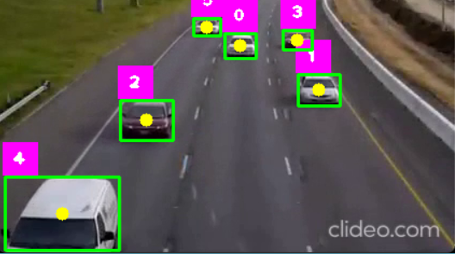
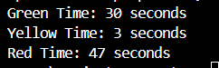
Working:
Case 2: low traffic density

Slide 12
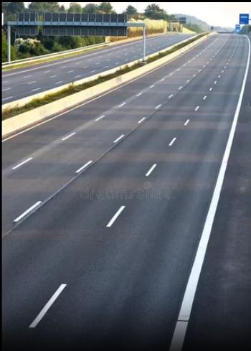
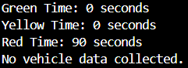
Working:
Case 3: empty lane

Slide 13
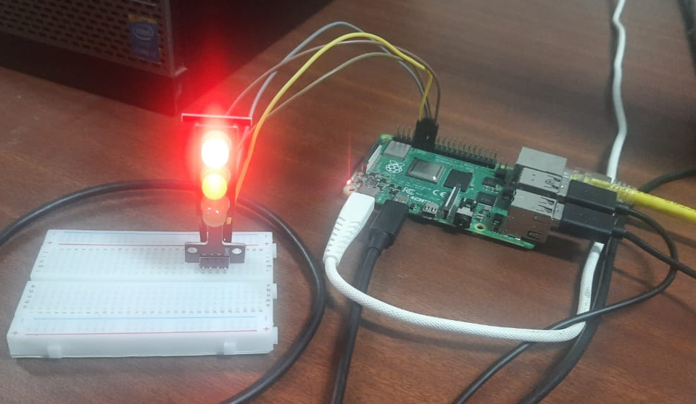
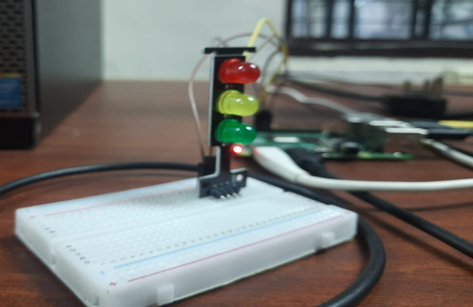
Project Setup Photos

Slide 14
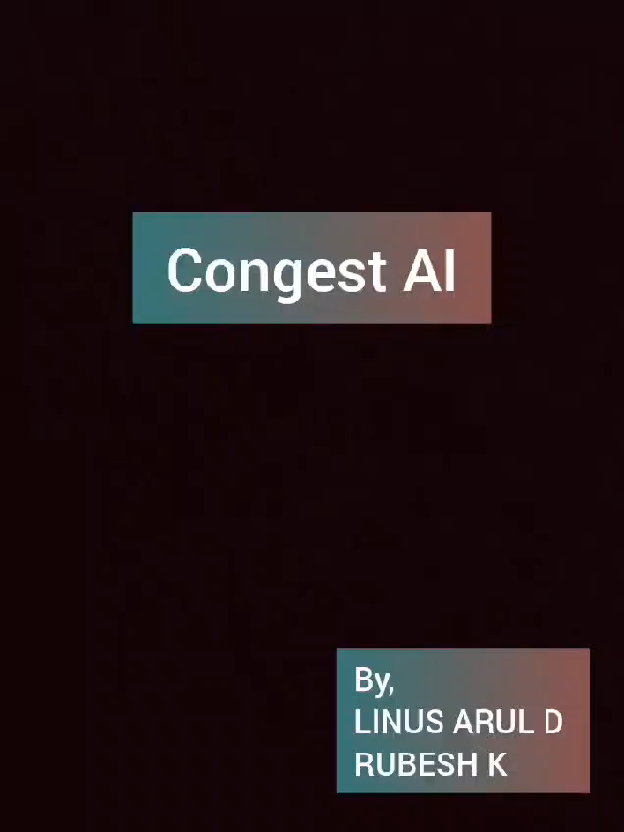
Project Demo

Slide 15
THANK YOU
🙏🏻🙏🏻

